Slide 1

Minimally Invasive Solution for Prolapse repair

Slide 2
WHAT IS IT?
Single incision mesh for vaginal prolapse correction
For anterior, posterior and apical prolapse correction without needles
Fixed to the sacrospinous ligament with Anchorsure
Fixed to the internal obturator muscle by “pockets” (fibrosis)

Slide 3
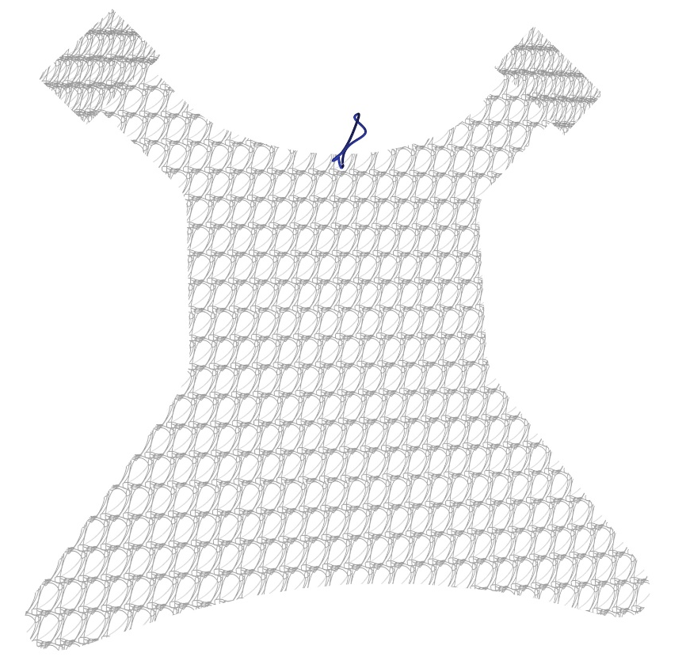
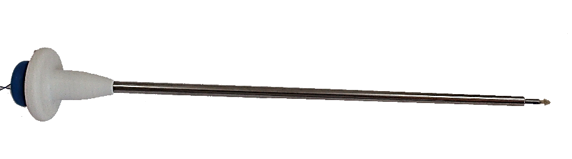
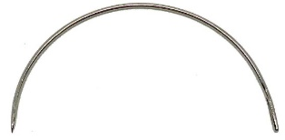
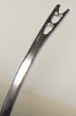
COMPLETE SYSTEM
Anchorsure
Free needle
Mesh

Slide 4
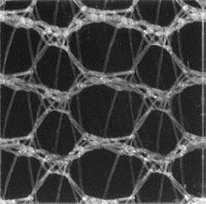
The Mesh
Material: Macropore polypropylene monofilament
Density: 28g/m² - ultralight
AMID Classification: Type I (pore >70µm)
Tensile strength break: 40N/cm

Slide 5

The mesh
MIPS offers versatility and can be adapted to any vaginal prolapse type. Depending on the prolapse location it will be used:
2 arms “pockets”: anterior and apical prolapse
    The mesh in placed between the bladder and the vagina
    It is a single incision mesh since only one incision is made in the vagina to place it (without needles)

Slide 6
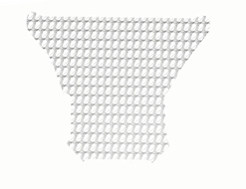
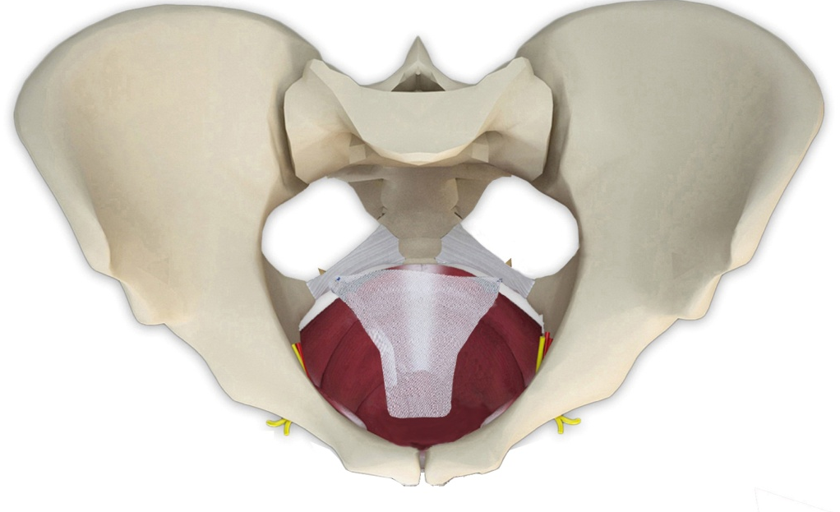
Without arms: posterior and apical prolapse
  The mesh is placed between the vagina and the rectus

Slide 7
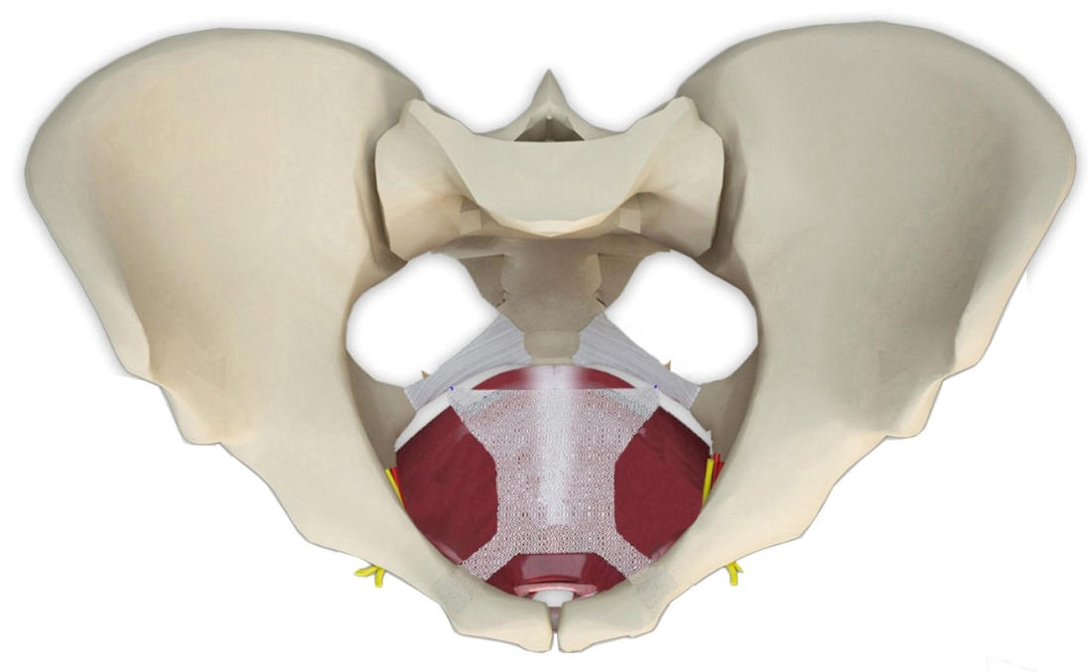
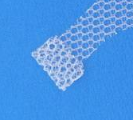
FIXATION POINTS
Posterior fixation: to the sacrospinous ligament with Anchorsure
Anterior fixation: to the internal obturator muscle. Fixation will be achieved by fibrosis of the tissue
1
2
1
2

Slide 8
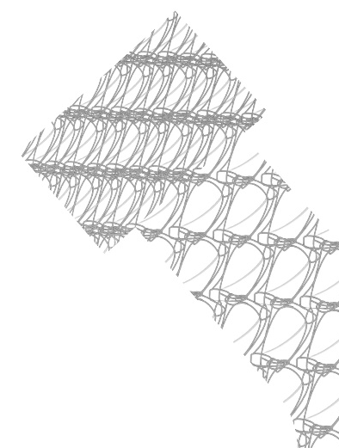
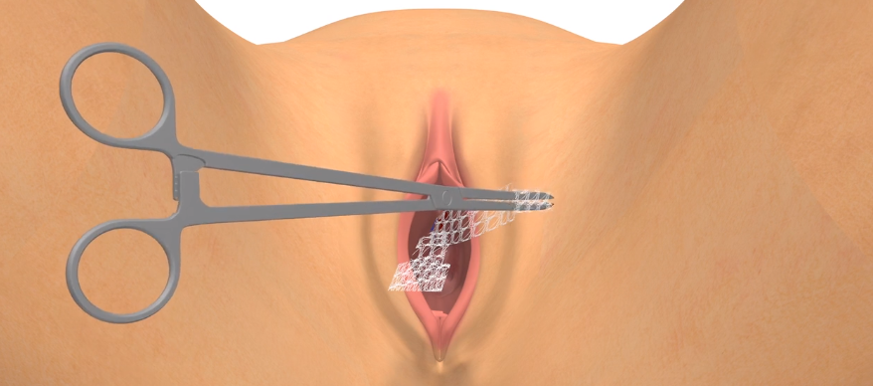
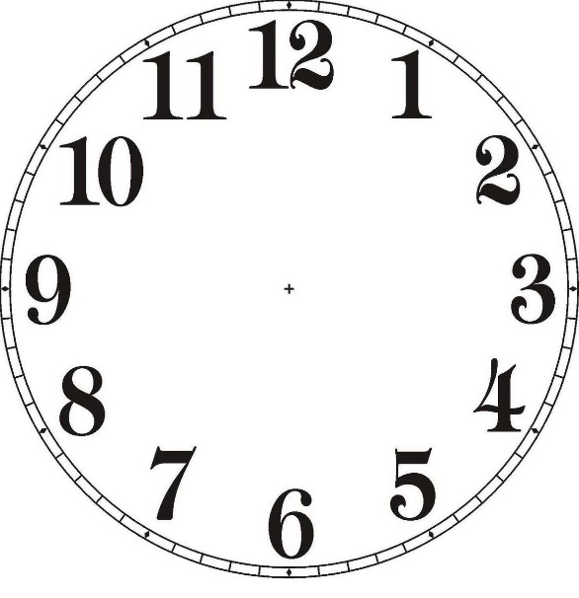
ARMS USE
Anterior arms or “pockets” are fixed inside the internal obturator muscle with a “Koher” type forceps in the 2 and 10 o’clock position.
The “pockets” offer a short term mechanical fixation but at mid and long term, fixation will be achieved by fibrosis.
The thread indicates the center of the mesh.

Slide 9
SUMMARY ADVANTATGES AND BENEFITS
Ultralight and big pore mesh
Minimally invasive solution for vaginal prolapse repair
Total mesh adjustability to reduce erosion and extrusion
Maximum versatility: same mesh for any compartment
Trimmable and adaptable mesh
Sacrospinous ligament fixation by Anchorsure

Slide 10
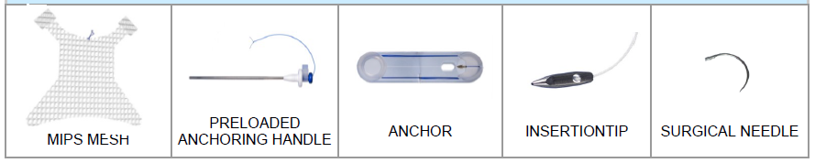
NECESSARY MATERIAL FOR SURGERY
KITMIPS02: Complete kit with single use sterile instruments

Slide 11
SURGICAL TECHNIQUE

Slide 12
REMINDER FOR OPERATING ROOM
If the complete kit is not used, the applicator APLIC 01 must be sterilized
Follow indications on the Anchorsure placement.
Important. Reminder on how to hold the mesh pocket with the forceps, and the forceps with the palm of your hand.
Important. Push the mesh with the forceps well into the inner obturator muscle on the right side until the blue central thread has passed the urethra more than 1 cm. on that side. When placing the left side pocket, push the forceps well into the internal obturator muscle until the central thread is centered below the urethra.

Slide 13
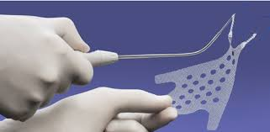
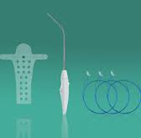
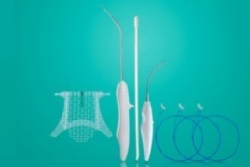
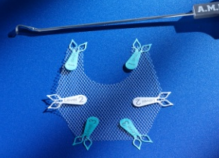
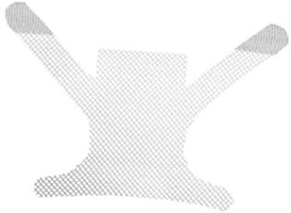
COMPETETITION
Vídeos
1. Promedon - Calistar A / P / S
2. AMI - InGYNious
3. Coloplast - Restorelle

Slide 14
HEALTHCARE PROFESSIONALS BENEFITS
BENEFITS AGAINST OTHER MESHES / SYSTEMS
  Single incision mesh (less invasive, less groin pain)
  Mesh adjustability: prevents wrinkle formation
  Versatility: same mesh for any prolapse
  All the advantages offered by Anchorsure compared to other sacrospinous ligament fixation systems

Slide 15
PATIENT’S BENEFITS
Producto
Less invasive as it is a single incision mesh
Allows adaptability to decrease risk of erosions

Slide 16
MIPS
KEY MESSAGES
Materiales
Vídeos
Single incision mesh: less risk of groin pain
Versatility: for any type of prolapse
Adjustability: reduces erosion risk
Sacrospinous ligament fixation with anchors: reduces risk of vaginal shortening

Slide 17

THANK YOU

